Slide 1
Violent crimes Per Population & communities
Shon Mohsin and Laura Niederlander
26 July, 2018

Slide 2
Data Defined
Many variables are included to weight attributes to be tested. Unrelated attributes were not included; attributes were picked if there was any plausible connection to crime (N=122), plus the attribute to be predicted (Per Capita Violent Crimes).
The variables included in the dataset involve the community, such as the percent of the population considered urban, and the median family income, and involving law enforcement, such as per capita number of police officers, and percent of officers assigned to drug units.
The per capita violent crimes variable was calculated using population and the sum of crime variables considered violent crimes in the United States: murder, rape, robbery, and assault.
There was apparently some controversy in some states concerning the counting of rapes. These resulted in missing values for rape, which resulted in incorrect values for per capita violent crime.
These cities are not included in the dataset. Many of these omitted communities were from the midwestern USA.
Notes:
Data Set Information:
Many variables are included so that algorithms that select or learn weights for
attributes could be tested. However, clearly unrelated attributes were not included;
attributes were picked if there was any plausible connection to crime (N=122), plus
the attribute to be predicted (Per Capita Violent Crimes). The variables included in
the dataset involve the community, such as the percent of the population considered
urban, and the median family income, and involving law enforcement, such as per capita
number of police officers, and percent of officers assigned to drug units.
The per capita violent crimes variable was calculated using population and the sum of
crime variables considered violent crimes in the United States: murder, rape, robbery,
and assault. There was apparently some controversy in some states concerning the
counting of rapes. These resulted in missing values for rape, which resulted in
incorrect values for per capita violent crime. These cities are not included in the
dataset. Many of these omitted communities were from the midwestern USA.
Data is described below based on original values. All numeric data was normalized into
the decimal range 0.00-1.00 using an Unsupervised, equal-interval binning method.
Attributes retain their distribution and skew (hence for example the population
attribute has a mean value of 0.06 because most communities are small). E.g. An
attribute described as 'mean people per household' is actually the normalized (0-1)
version of that value.
The normalization preserves rough ratios of values WITHIN an attribute (e.g. double
the value for double the population within the available precision - except for
extreme values (all values more than 3 SD above the mean are normalized to 1.00; all
values more than 3 SD below the mean are nromalized to 0.00)).
However, the normalization does not preserve relationships between values BETWEEN
attributes (e.g. it would not be meaningful to compare the value for whitePerCap with
the value for blackPerCap for a community)
A limitation was that the LEMAS survey was of the police departments with at least 100
officers, plus a random sample of smaller departments. For our purposes, communities
not found in both census and crime datasets were omitted. Many communities are missing
LEMAS data.

Slide 3
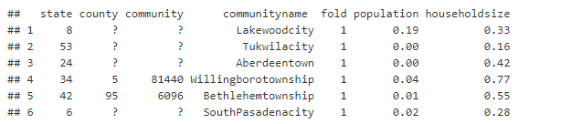

Slide 4
Real World Stories

Slide 5
Dataset
Demographic information includes: (122 predictive, 5 non-predictive, 1 goal)
5 Non-Predictive
US State, County, Communities, Community Names, Fold
122 Predictive
Age, Ethnicity, Education, Income, Employment, Social-Eco Status, Household size, Marital status, Immigrants, language, Household dynamics, home ownership, living assistance, origin, Police presence, transportation, urban/rual, land density.
1 goal
Violent Crime Per Population

Slide 6
Define predictors and goals
Community Name:
community name - not predictive - for information only (string)
Goal
-- ViolentCrimesPerPop: total number of violent crimes per 100K population (numeric - decimal) GOAL attribute (to be predicted)
Predictive
-- agePct12t29: percentage of population that is 12-29 in age (numeric - decimal)
-- medIncome: median household income (numeric - decimal)
-- blackPerCap: per capita income for african americans (numeric - decimal)
-- HispPerCap: per capita income for people with hispanic heritage (numeric - decimal)
-- RentLowQ: rental housing - lower quartile rent (numeric - decimal)
-- PctLess9thGrade: percentage of people 25 and over with less than a 9th grade education (numeric - decimal)

Slide 7
Hypothesis
Hypothesis
Critical Value
P-Value
Decision:
Conclusion

Slide 8
Assumptions
Linearity – Met with Log-Log model
Normality – Log-log model looks slightly better
Equal Standard Deviations – review residual plots
Independence –We assume independence.
Outliers – There are no major outliers
Inference -

Slide 9
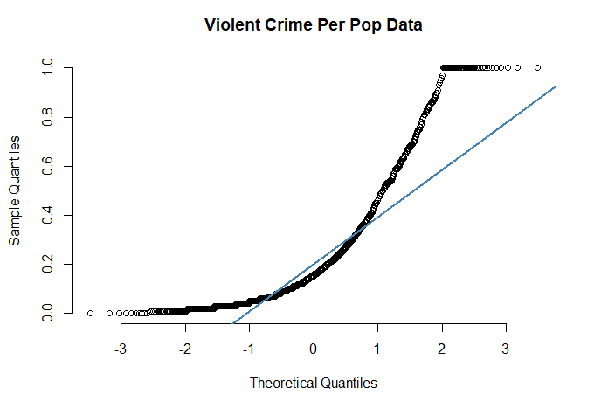
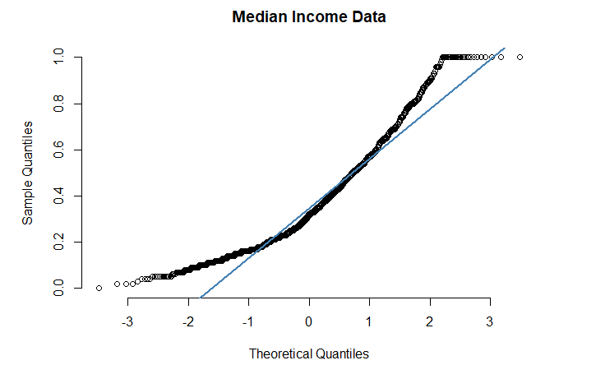
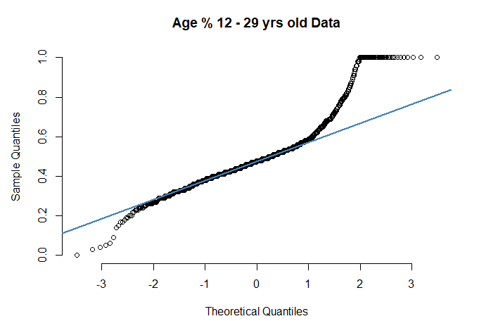
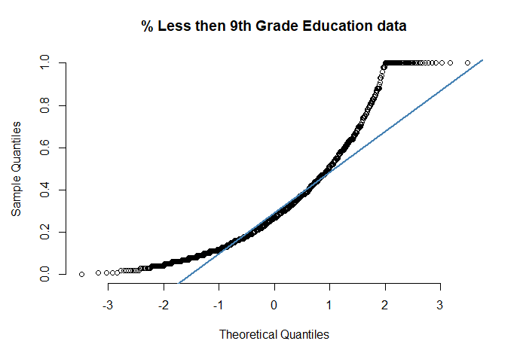
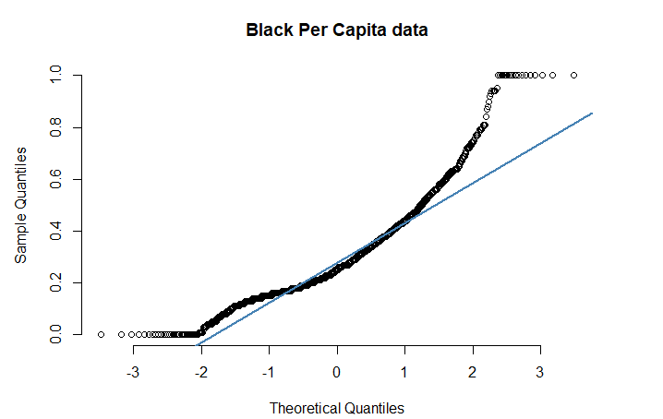
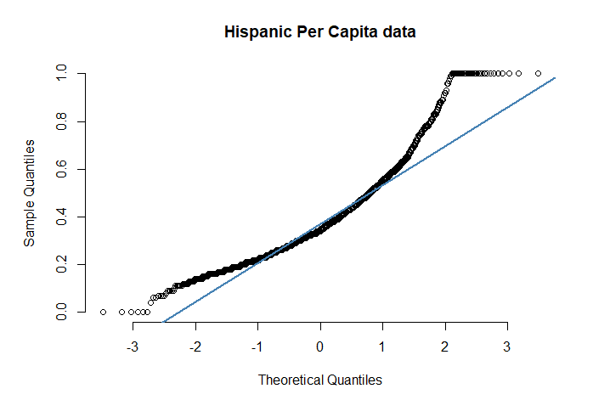
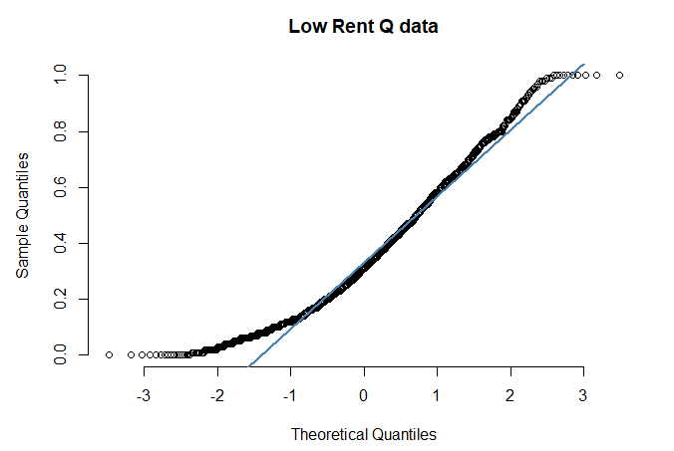
Plots
Notes:
#Check for normality
qqnorm(cdss$crimedata.ViolentCrimesPerPop, pch = 1, frame = FALSE, main= "Violent Crime Per Pop Data") ## plots the data qqline(cdss$crimedata.ViolentCrimesPerPop, col = "steelblue", lwd = 2) ## adds a line

Slide 10
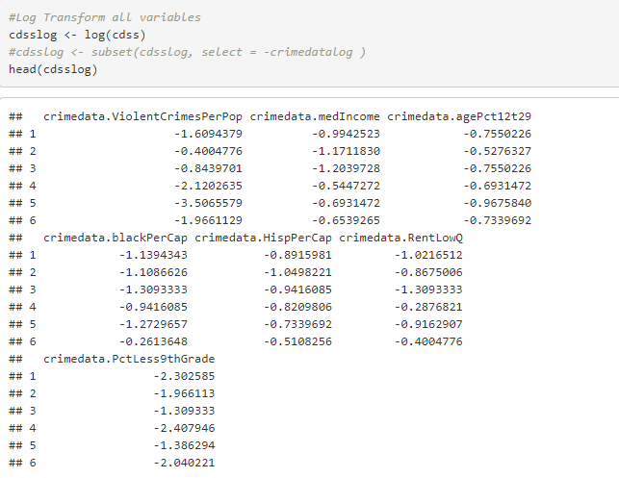
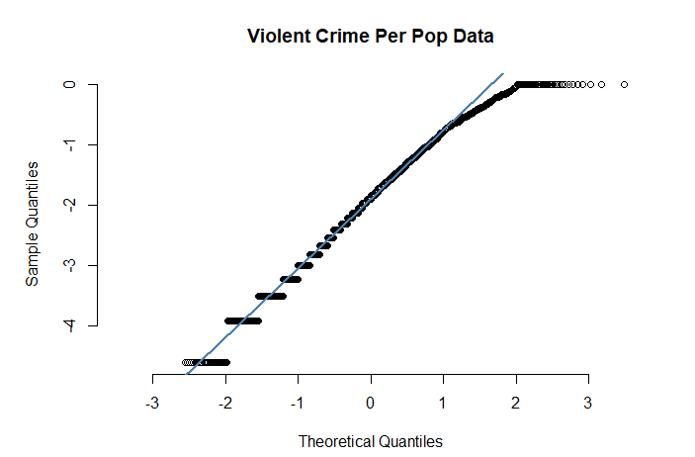
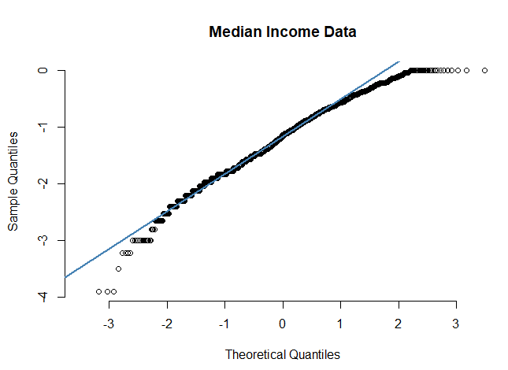
Log Transform

Slide 11
Log transformed plots

Slide 12
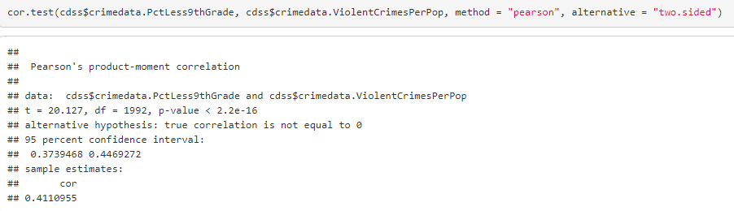
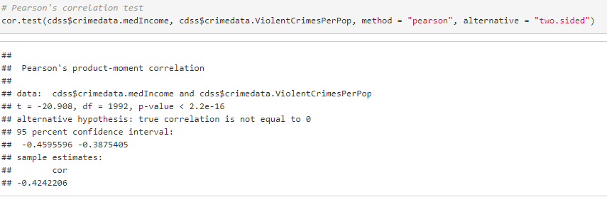
Correlation
% Less than 9th Grade Education correlation to Violent Crimes per population is moderately correlated at 0.411
Median Income shows negative correlation at -0.424
All there predictors were less than 0.2 in correlation.

Slide 14
Findings

Slide 15
conclusion

Slide 16
Citation
U. S. Department of Commerce, Bureau of the Census, Census Of Population And Housing 1990 United States: Summary Tape File 1a & 3a (Computer Files),
U.S. Department Of Commerce, Bureau Of The Census Producer, Washington, DC and Inter-university Consortium for Political and Social Research Ann Arbor, Michigan. (1992)
U.S. Department of Justice, Bureau of Justice Statistics, Law Enforcement Management And Administrative Statistics (Computer File) U.S. Department Of Commerce, Bureau Of The Census Producer, Washington, DC and Inter-university Consortium for Political and Social Research Ann Arbor, Michigan. (1992)
U.S. Department of Justice, Federal Bureau of Investigation, Crime in the United States (Computer File) (1995)
Redmond, M. A. and A. Baveja: A Data-Driven Software Tool for Enabling Cooperative Information Sharing Among Police Departments. European Journal of Operational Research 141 (2002) 660-678.

